Slide 1
MPLS Introduction
Multi-Protocol Label Switching

Slide 2
MPLS Introduction
Motivation
MPLS Basics
Components and Protocols
Operation
Protocol Stack Architecture
Advantages and Disadvantages

Slide 3
Motivation
IP
  The first defined and used protocol
  De facto the only protocol for global Internet working
… but there are disadvantages

Slide 4
Motivation (cont.)
IP Routing disadvantages
  Connectionless
  - e.g. no QoS
  Each router has to make independent forwarding decisions based on the IP-address
  Large IP Header
  - At least 20 bytes
  Routing in Network Layer
  - Slower than Switching
  Usually designed to obtain shortest path
  - Do not take into account additional metrics

Slide 5
Motivation (cont.)
ATM
  connection oriented
  - Supports QoS
  fast packet switching with fixed length packets (cells)
  integration of different traffic types (voice, data, video)
… but there are also disadvantages

Slide 6
Motivation (cont.)
ATM disadvantages
  Complex
  Expensive
  Not widely adopted

Slide 7
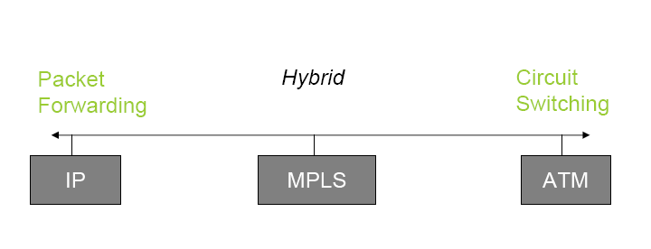
Motivation (cont.)
Idea: Combine the forwarding algorithm used in ATM with IP.

Slide 8
Need for MPLS
Rapid growth of Internet
New latency dependent applications
Quality of Service (QoS)
  Less time at the routers
Traffic Engineering
  Flexibility in routing packets
Connection-oriented forwarding techniques with connectionless IP
  Utilizes the IP header information to maintain interoperability with IP based networks
  Decides on the path of a packet before sending it

Slide 9
MPLS Introduction
Motivation
MPLS Basics
Components and Protocols
Operation
Protocol Stack Architecture
Advantages and Disadvantages

Slide 10
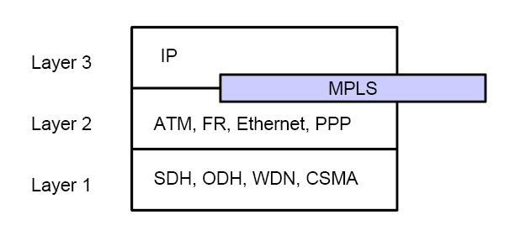
MPLS Basics
Multi Protocol Label Switching is arranged between Layer 2 and Layer 3

Slide 11
MPLS Basics (cont.)
MPLS Characteristics
  Mechanisms to manage traffic flows of various granularities (Flow Management)
  Is independent of Layer-2 and Layer-3 protocols
  Maps IP-addresses to fixed length labels
  Interfaces to existing routing protocols (RSVP, OSPF)
  Supports ATM, Frame-Relay and Ethernet

Slide 12
MPLS Introduction
Motivation
MPLS Basics
MPLS Components and Protocols
MPLS Operation
MPLS Protocol Stack Architecture
Advantages and Disadvantages

Slide 13
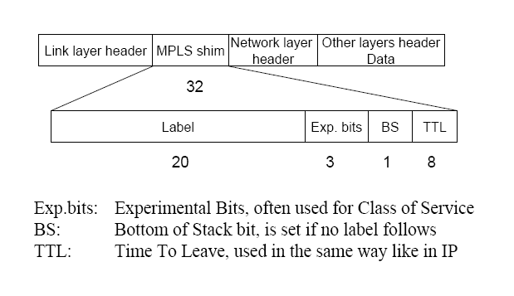
Label
Generic label format

Slide 14
Label (cont.)
Label distribution
  MPLS does not specify a single method for label distribution
  BGP has been enhanced to piggyback the label information within the contents of the protocol
  RSVP has also been extended to support piggybacked exchange of labels.

Slide 15
Label (cont.)
  IETF has also defined a new protocol known as the label distribution protocol (LDP) for explicit signaling and management
  Extensions to the base LDP protocol have also been defined to support explicit routing based on QoS requirements.

Slide 16
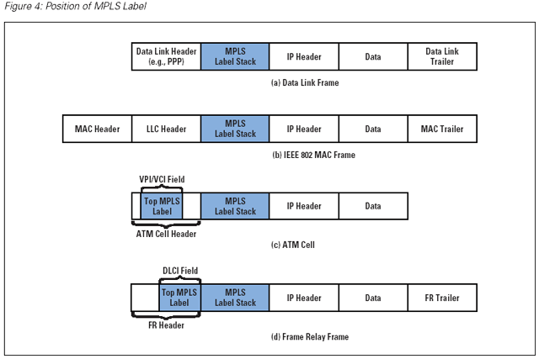
Label (cont.)

Slide 17
Label Edge Router - LER
Resides at the edge of an MPLS network and assigns and removes the labels from the packets.
Support multiple ports connected to dissimilar networks (such as frame relay, ATM, and Ethernet).

Slide 18
Label Switching Router - LSR
Is a high speed router in the core on an MPLS network.
ATM switches can be used as LSRs without changing their hardware. Label switching is equivalent to VP/VC switching.

Slide 19
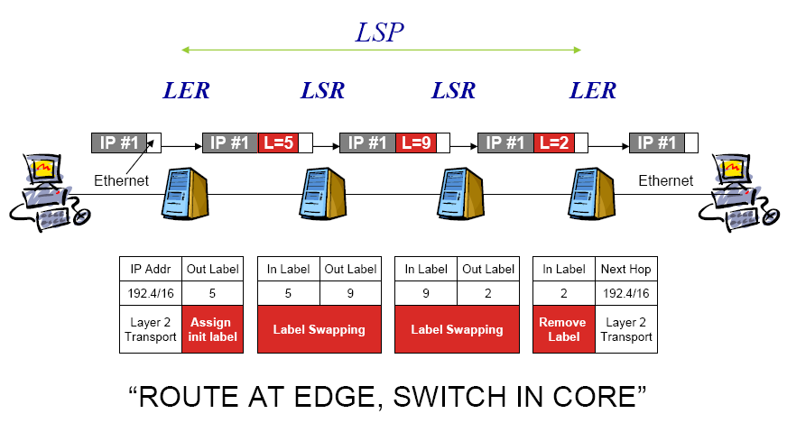
Positions of LERs & LSRs

Slide 20
Forward Equivalence Class - FEC
Is a representation of a group of packets that share the same requirements for their transport.
The assignment of a particular packet to a particular FEC is done just once (when the packet enters the network).

Slide 21
Label-Switched Paths - LSPs
A path is established before the data transmission starts.
A path is a representation of a FEC.

Slide 22
LSP Details
MPLS provides two options to set up an LSP
  hop-by-hop routing
  Each LSR independently selects the next hop for a given FEC. LSRs support any available routing protocols (OSPF, ATM …).
  explicit routing
  Is similar to source routing. The ingress LSR specifies the list of nodes through which the packet traverses.
The LSP setup for an FEC is unidirectional. The return traffic must take another LSP!

Slide 23
Label Distribution Protocol - LDP
An application layer protocol for the distribution of label binding information to LSRs.
  It is used to map FECs to labels, which, in turn, create LSPs.
  LDP sessions are established between LDP peers in the MPLS network (not necessarily adjacent).
  Sometimes employs OSPF or BGP.

Slide 24
LDP details
LDP message types:
  discovery messages—announce and maintain the presence of an LSR in a network
  session messages—establish, maintain, and terminate sessions between LDP peers
  advertisement messages—create, change, and delete label mappings for FECs
  notification messages—provide advisory information and signal error information

Slide 25
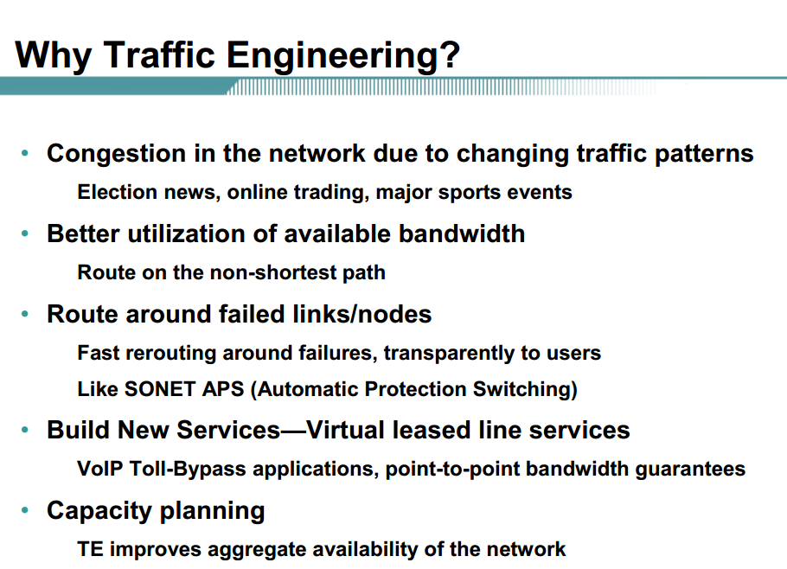


Slide 26
Traffic Engineering
In MPLS, traffic engineering is inherently provided using explicitly routed paths.
The LSPs are created independently, specifying different paths that are based on user-defined policies. However, this may require extensive operator intervention.
RSVP-TE and CR-LDP are two possible approaches to supply dynamic traffic engineering and QoS in MPLS.

Slide 27
RSVP-TE
Request bandwidth and traffic conditions on a defined path.
Drawback:
  Requires regular refreshes
  Scalability

Slide 28
CR-LDP
Takes into account parameters, such as link characteristics (bandwidth, delay, etc.), hop count, and QoS.
It is entirely possible that a longer (in terms of cost) but less loaded path is selected.
Drawback: It adds more complexity to routing calculations.

Slide 29
MPLS Introduction
Motivation
MPLS Basics
Components and Protocols
Operation
Protocol Stack Architecture
Advantages and Disadvantages

Slide 30
MPLS Operation
The following steps must be taken for a data packet to travel through an MPLS domain.
  label creation and distribution
  table creation at each router
  label-switched path creation
  label insertion/table lookup
  packet forwarding

Slide 31
Step 1
Label creation and label distribution
  Before any traffic begins the routers make the decision to bind a label to a specific FEC and build their tables.
  In LDP, downstream routers initiate the distribution of labels and the label/FEC binding.
  In addition, traffic-related characteristics and MPLS capabilities are negotiated using LDP.
  A reliable and ordered transport protocol should be used for the signaling protocol.

Slide 32
Step 2
Table creation
  On receipt of label bindings each LSR creates entries in the label information base (LIB).
  The contents of the table will specify the mapping between a label and an FEC.
    mapping between the input port and input label table to the output port and output label table.
    The entries are updated whenever renegotiation of the label bindings occurs.

Slide 33
Example of LIB Table
Input Port | Incoming Port Label | Output Port | Outgoing Port Label
1 | 3 | 3 | 6
2 | 9 | 1 | 7

Slide 34
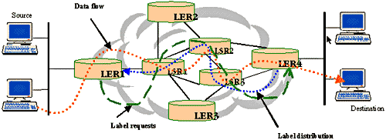
MPLS Operation Example

Slide 35
Step 3
Label switched path creation
  The LSPs are created in the reverse direction to the creation of entries in the LIBs.

Slide 36
MPLS Operation Example

Slide 37
Step 4
Label insertion/table-lookup
  The first router (LER1) uses the LIB table to find the next hop and request a label for the specific FEC.
  Subsequent routers just use the label to find the next hop.
  Once the packet reaches the egress LSR (LER4), the label is removed and the packet is supplied to the destination.

Slide 38
MPLS Operation Example

Slide 39
Step 5
Packet forwarding
  LER1 may not have any labels for this packet as it is the first occurrence of this request. In an IP network, it will find the longest address match to find the next hop. Let LSR1 be the next hop for LER1.
  LER1 will initiate a label request toward LSR1.
  This request will propagate through the network as indicated by the broken green lines.

Slide 40
Step 5 (cont.)
  Each intermediary router will receive a label from its downstream router starting from LER2 and going upstream till LER1. The LSP setup is indicated by the broken blue lines using LDP or any other signaling protocol. If traffic engineering is required, CR–LDP will be used in determining the actual path setup to ensure the QoS/CoS requirements are complied with.
  LER1 will insert the label and forward the packet to LSR1.

Slide 41
Step 5 (cont.)
  Each subsequent LSR, i.e., LSR2 and LSR3, will examine the label in the received packet, replace it with the outgoing label and forward it.
  When the packet reaches LER4, it will remove the label because the packet is departing from an MPLS domain and deliver it to the destination.
  The actual data path followed by the packet is indicated by the broken red lines.

Slide 42
MPLS Operation Example

Slide 43
Tunneling in MPLS
Control the entire path of a packet without explicitly specifying the intermediate routers.
  Creating tunnels through the intermediary routers that can span multiple segments.
MPLS based VPNs.

Slide 44
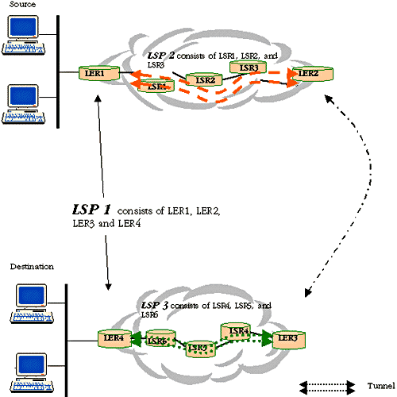

Slide 45
MPLS Introduction
Motivation
MPLS Basics
Components and Protocols
Operation
Protocol Stack Architecture
Advantages and Disadvantages

Slide 46
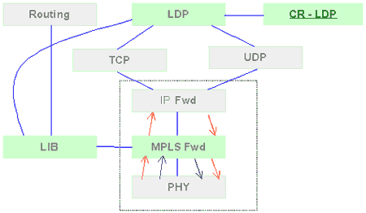
MPLS Protocol Stack Architecture

Slide 47
MPLS Introduction
Motivation
Basics
Components and Protocols
Operation
Protocol Stack Architecture
Advantages and Disadvantages

Slide 48
MPLS Advantages
Improves packet-forwarding performance in the network
Supports QoS and CoS for service differentiation
Supports network scalability
Integrates IP and ATM in the network
Builds interoperable networks

Slide 49
MPLS Disadvantages
An additional layer is added
The router has to understand MPLS

Slide 50
Questions
What the need for MPLS
Review the applications of MPLS into creating VPN
Discuss Traffic engineering issues in MPLS

Slide 51
References
http://www.iec.org/online/tutorials/mpls/index.html
http://www.iaik.tu-graz.ac.at/teaching/03_advanced%20computer%20networks/ss2004/vo3/MPLS.pdf
http://ica1www.epfl.ch/cn2/0304/doc/lecture/mpls.pdf

